Slide 1
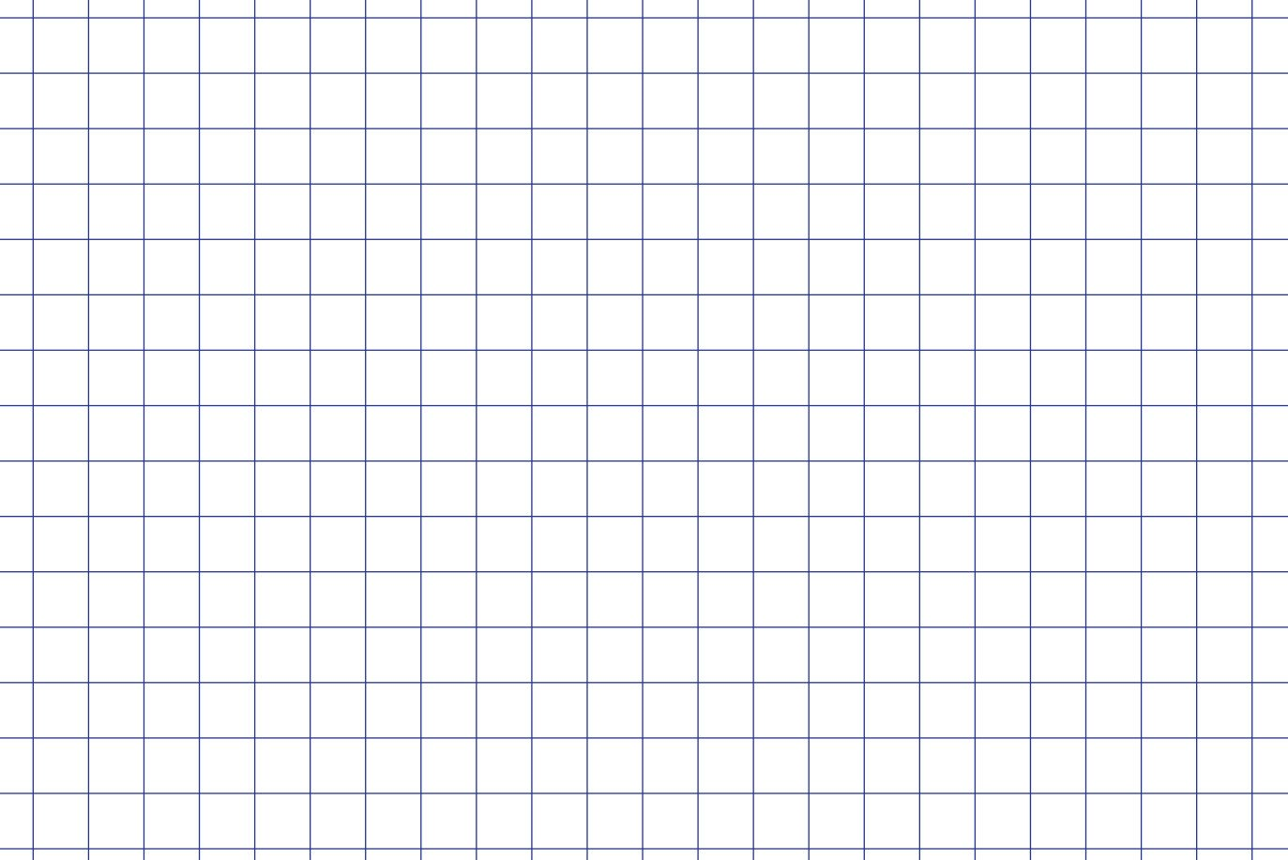


User Interfaces
Python PyQT and QT Designer
Rapid GUI Programming with Python and Qt - The Definitive Guide to PyQt Programming.

Slide 2
GOALS
Consider the basics of good user interface design.
Examine a simple GUI (Expression Calculator) and understand basic of PyQT
Familiarise ourselves with QT Designer
Port one of your previous weekly assignments to a GUI program
Share your program on GitHub with a classmate
Making sure your code can run on another machine and that your UI/Code is clear. Include relevant Docs’ if necessary.

Slide 3
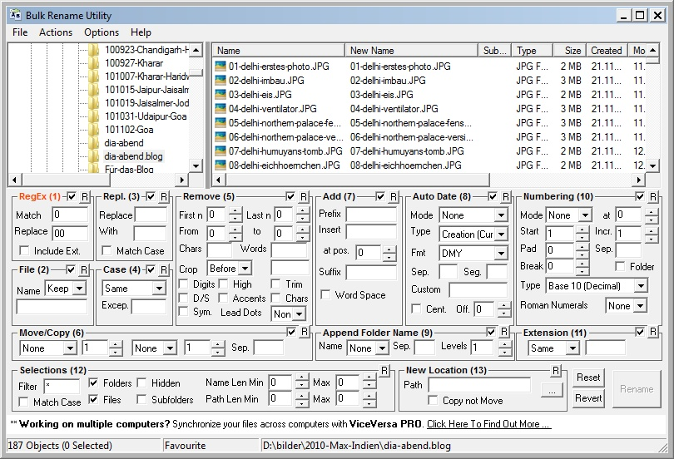
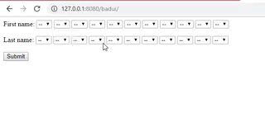
Good UI Design:
The best way to appreciate good UI design is to consider bad UI design.

Slide 4
Good UI Design:
Ideally, we want the user get using the software as easily as possible.
Additional functionality can be access as their confidence grows with the software.
Keep it simple, informative and easy to use.

Slide 5
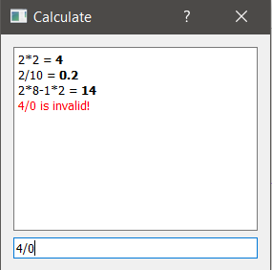
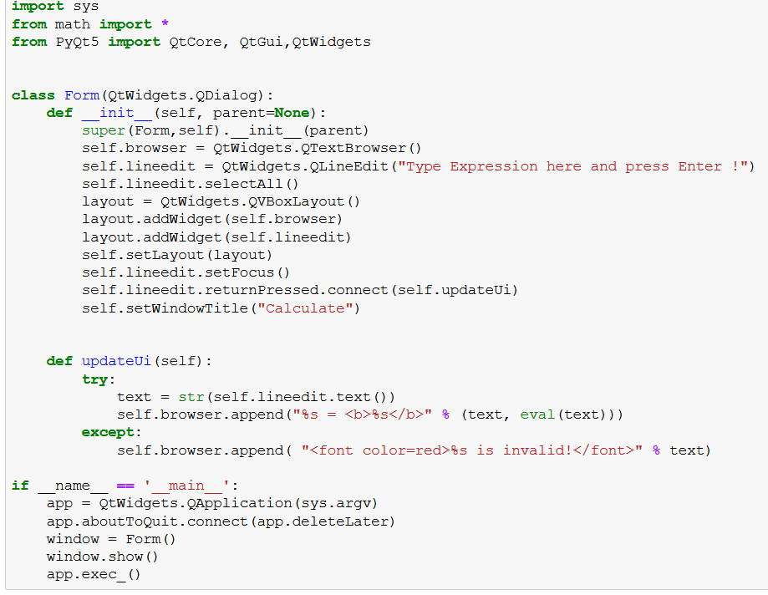
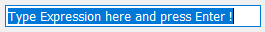
Simple Expression Calculator:

Slide 6
Simple Expression Calculator:
Required Imports: Most of the useful classes have been moved into QtWidgets

Slide 7
Simple Expression Calculator:
Required Imports: Most of the useful classes have been moved into QtWidgets
Build UI Objects, waits for expression to be entered

Slide 8
Simple Expression Calculator:
Required Imports: Most of the useful classes have been moved into QtWidgets
Build UI Objects, waits for expression to be entered
Does the calculation and updated UI

Slide 9
Simple Expression Calculator:
Required Imports: Most of the useful classes have been moved into QtWidgets
Build UI Objects, waits for expression to be entered
Does the calculation and updated UI
Runs the UI and makes sure it exits safely

Slide 10
QT Creator:
Much of the code involved setting up the actual window and this becomes more complicated for more complex projects.
QT Creator allows us to build the window and just refer to the objects in the code.
We must be consistent with our naming and the objects we use

Slide 11
Exercise 1:
Lets convert our Simple Expression Calculator to use a pre-designed UI instead.
Launch Anaconda Prompt:
1. TYPE: jupyter notebook
2. TYPE: designer
Add Line Edit – input widget (Give it a name).
Add Text Browser – display widget (Give it a name).

Slide 12
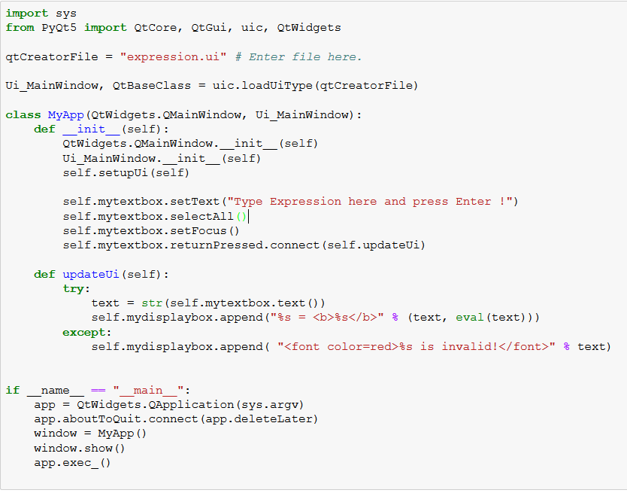
Exercise 1:
Required Import & Load our prebuilt UI.

Slide 13
Exercise 1:
Required Import & Load our prebuilt UI.
Initialize UI, Allow for reference to UI objects i.e. self.mytextbox
As before, preform calculation.

Slide 14
Exercise 1:
Required Import & Load our prebuilt UI.
Initialize UI, Allow for reference to UI objects i.e. self.mytextbox
As before, preform calculation.
Runs the UI and makes sure it exits safely

Slide 15
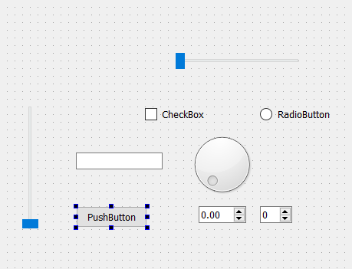
QT Creator:
Gives us much a lot of choice in the way of user input. Buttons, Boolean boxes, sliders, line inputs etc.

Slide 16
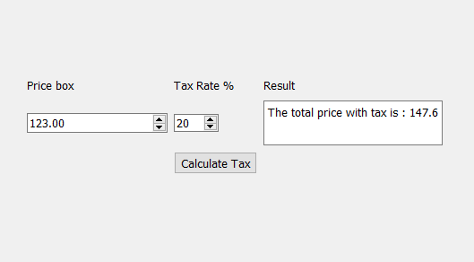
Exercise 2:
Calculate tax example:
Use double spin box for input
Use int spin box for tax rate%
Use Button for action
Display in line edit box

Slide 17
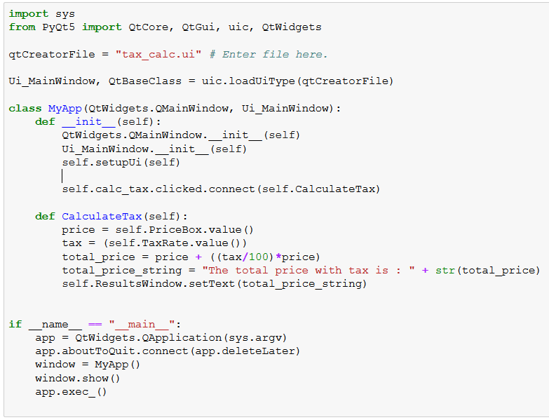
Exercise 2:
Shows how we interact with these input widgets!

Slide 18
QT Creator:
The last thing which might be useful is plotting creating plots with QT creator.
This is a little tricky so we’ll just outline the method and go through the example code.
QT has no plugin for matplotlib so we have to cheat a bit.

Slide 19
Final Exercise:
Covert one of your own programs.
(I would suggest importing it as a package a just referring to it when needed in the UI program)
Share this with a class mate to ensure:
It can run on another's machine.
They can figure out how to use it.

